Slide 1


Arrays in C
Arrays are a fundamental data structure in C, used to store collections of similar data types. They provide a structured and efficient way to manage related data, making your C programs more organized.
by Istiak Rahman

Slide 2
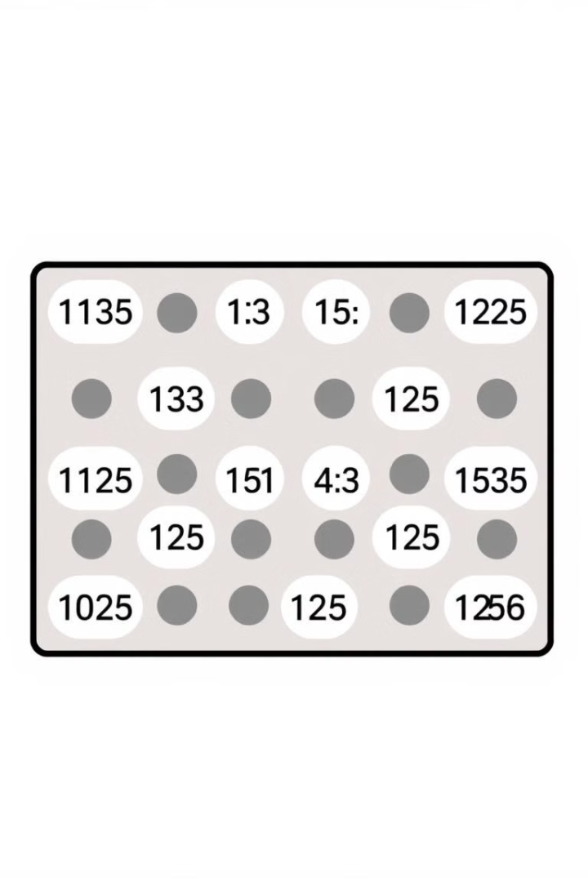
One-Dimensional Arrays: The Basics
1
Declaration
You declare a 1D array by specifying the data type, array name, and size using square brackets.
2
Initialization
You can initialize an array with values during declaration, or assign values later using indices.
3
Accessing Elements
Each element is accessed using an index, starting from 0, within square brackets.

Slide 3
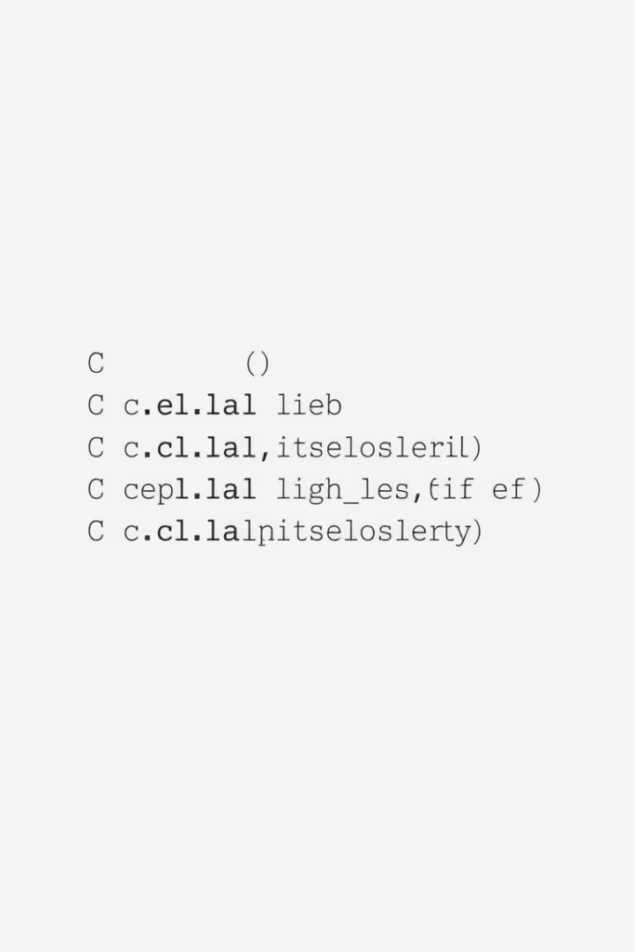
Working with One-Dimensional Arrays
1
Traversing
You can loop through an array using a for loop to access and process each element.
2
Modifying Elements
You can modify the value of individual elements by assigning new values using their indices.
3
Calculating Sum and Average
You can calculate the sum and average of all elements using a loop and some arithmetic operations.
4
Searching for a Value
You can search for a specific value within the array using a loop and comparison operators.

Slide 4
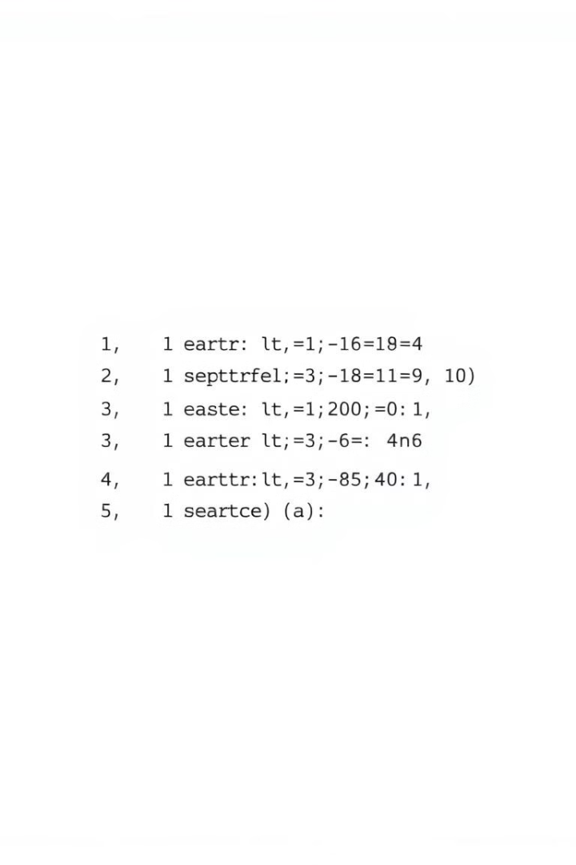
Advantages of Using Arrays
Efficient Memory Management
Arrays store elements contiguously, making it efficient to access and process data.
Random Access
You can access any element in an array directly using its index, without iterating through others.
Improved Data Organization
Arrays provide a structured way to manage related data, making programs more organized and readable.

Slide 5
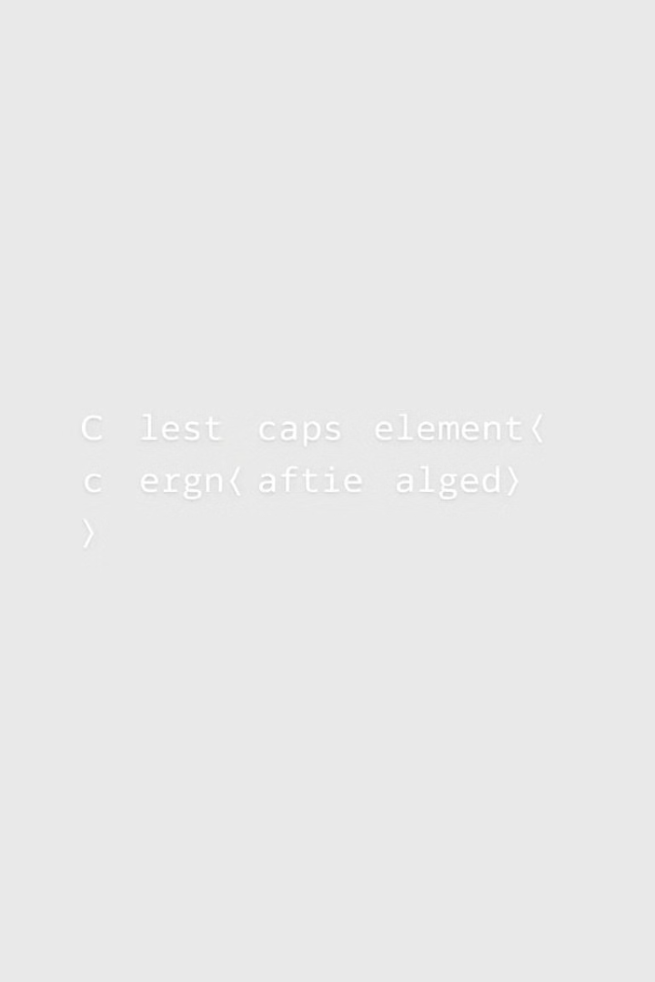




Limitations of Arrays
Fixed Size
The size of an array is fixed at declaration and cannot be changed during program execution.
Continuous Memory
Arrays require contiguous memory, which can be a problem for very large arrays.
Single Data Type
All elements in an array must be of the same data type, limiting flexibility.
Potential for Errors
Accessing elements outside the array bounds can lead to unpredictable errors.

Slide 6

Thank You!
Presented by: Istiak Rahman
Email: istiak.rahman1020@gmail.com
Thank you for your attention! I appreciate your time and interest.
Keep Learning, Keep Growing

